Slide 1
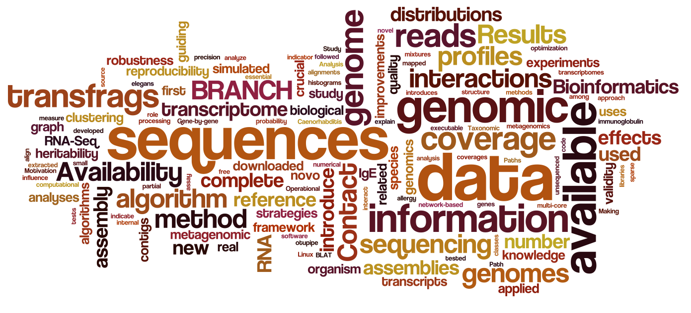
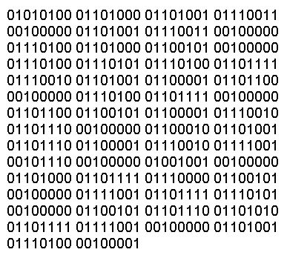
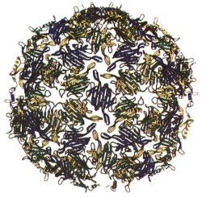
Avances en Computación en Ciencias de la Vida y
Aplicaciones en el Agro
Javier Sánchez Galán, PhD
Grupo de Investigación en Biotecnología, Bioinformática y Biología de Sistemas – GIBBS
Universidad Tecnológica de Panamá
23 de abril de 2018

Slide 2
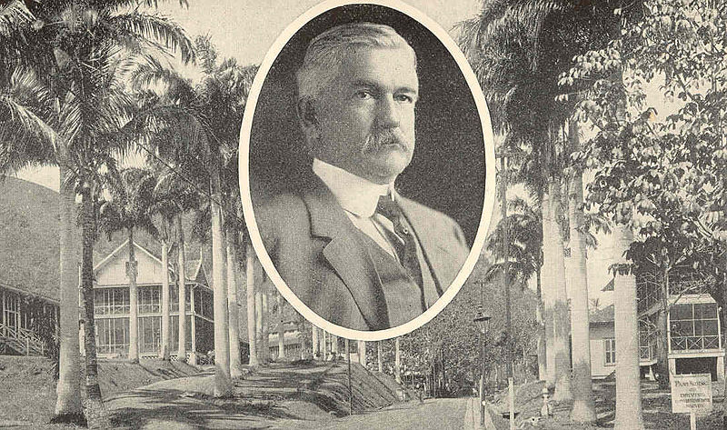
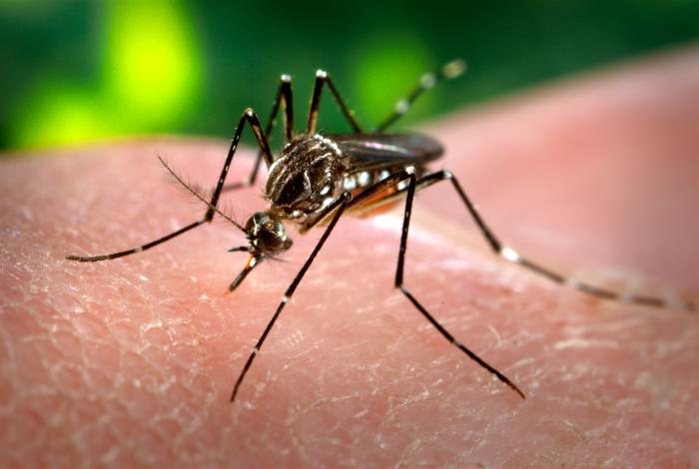
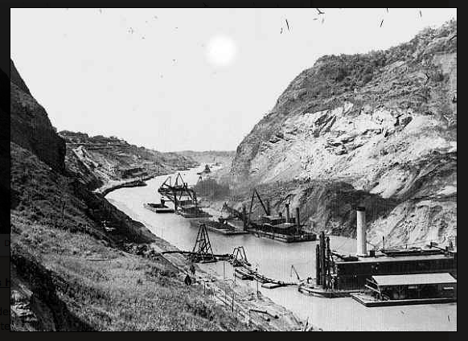
Science in Panama

Slide 3
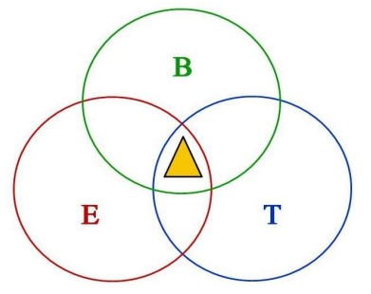
About Me
Short Bio:
BSc. Computer Systems Engineering, UTP
MSc, Computer Science (Bioinformatics), McGill
PhD, Experimental Medicine, McGill
I am a bio/chemo-infomatician with interest in innovative approaches for bridging computational and data analysis approaches for biology, chemistry, medicine, agriculture and climate research.
I am a researcher at the Centro de Producción e Investigaciones Agroindustriales (CEPIA)-UTP. Grupo de Investigaciones en Biotecnología, Bioinformática y Biología Sintética (GIBBS). Professor at Facultad de Ingenieria de Sistemas Computacionales (FISC). Adjunct Reseracher at INDICASAT-AIP.
Research interest:
- Machine learning and multivariate analysis applied to spectral signals (Mass Spectrometry, Near-infrared Spectroscopy). Also images, sounds.
- Applied High Performance Computing

Slide 4
Molecular Bio & Medicine

Slide 5
Bioinformatics?
COMPUTING
LIFE SCIENCES
MATH & STATS
BIO/CHEMO-INFORMATICS
Bioinformatics: study of the compuational methods needed for the generacion, managmente, storage and analysis of biologicla data.

Slide 6
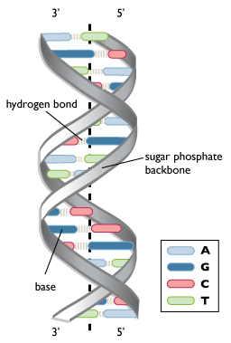
Range of Action of Bioinformatics

Slide 7
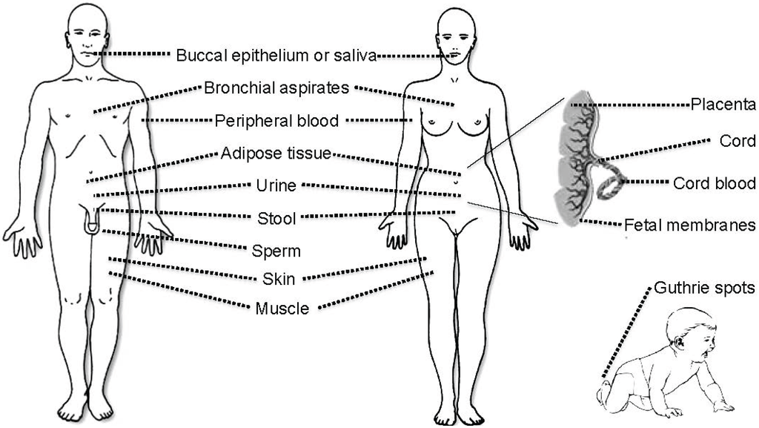
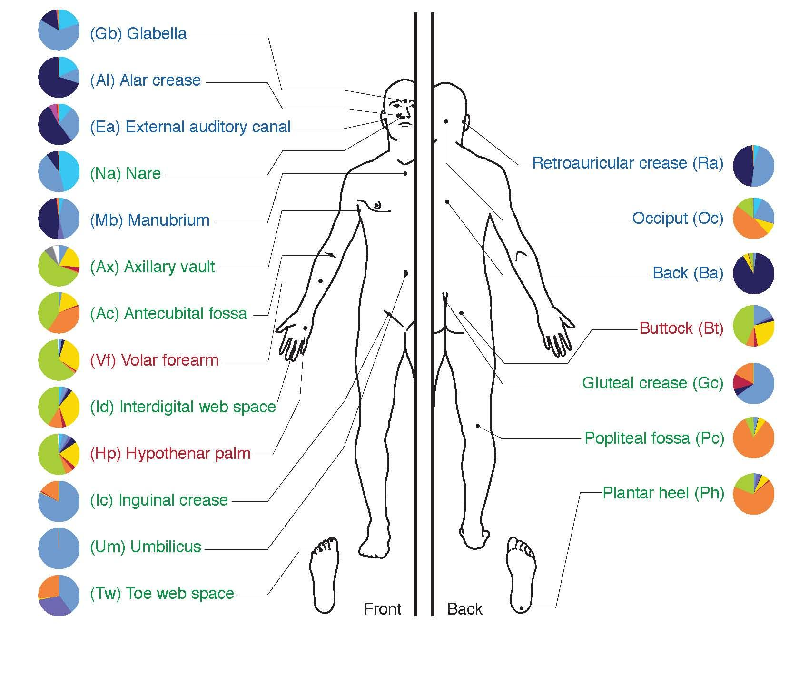
“-omics” Sciences

Slide 8
“-omics” Sciences

Slide 9
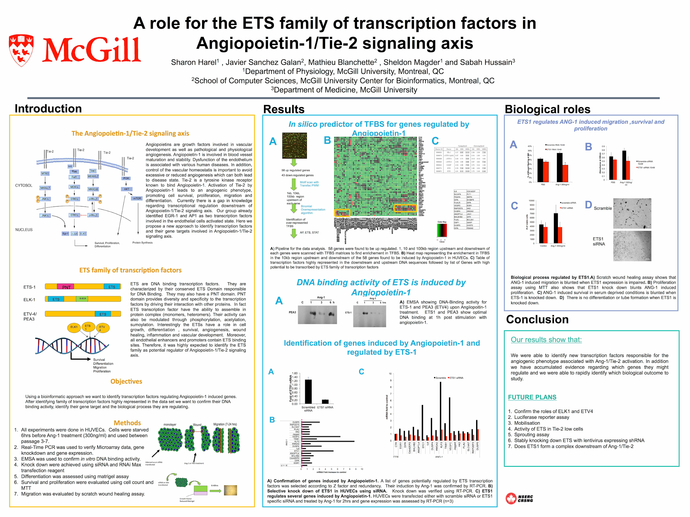
Transcription Factor Binding Site (TFBS) Prediction

Slide 10
“-omics” Sciences

Slide 11
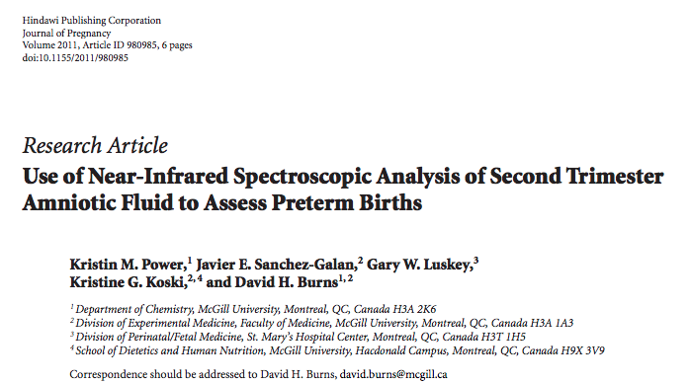
Use of Near-Infrared Spectroscopy and Chemoinformatic Analysis of Biological Fluids for the Assesment of Maternal-Fetal Health

Slide 12
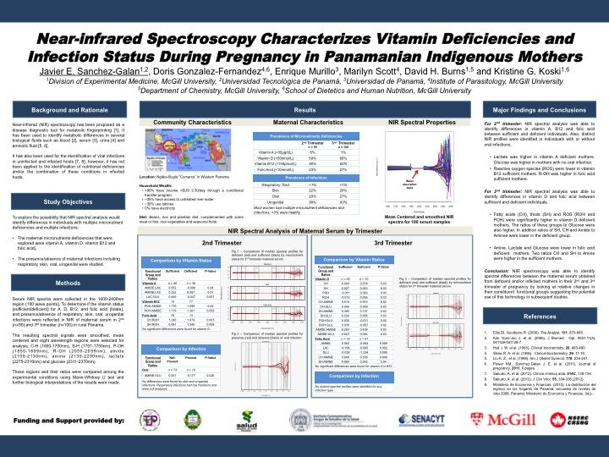
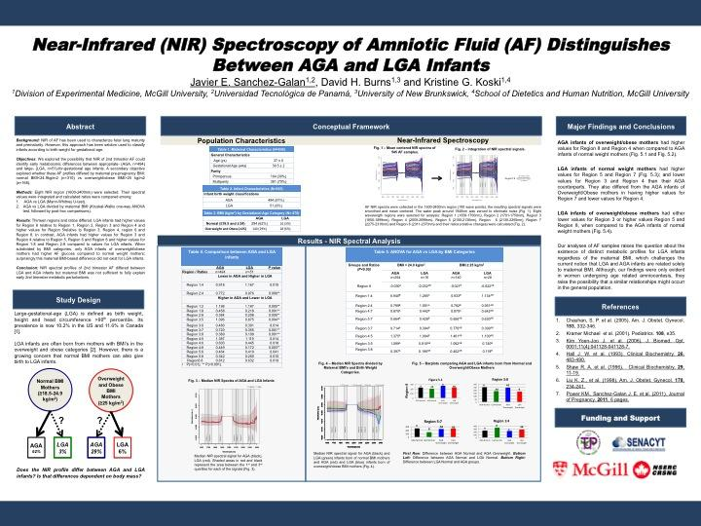
Use of Near-Infrared Spectroscopy and Chemoinformatic Analysis of Biological Fluids for the Assesment of Maternal-Fetal Health

Slide 13
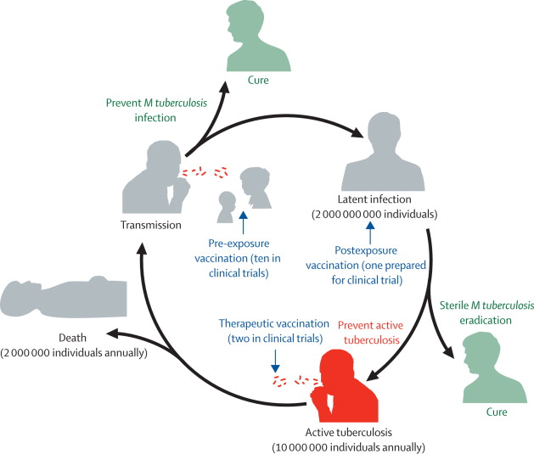
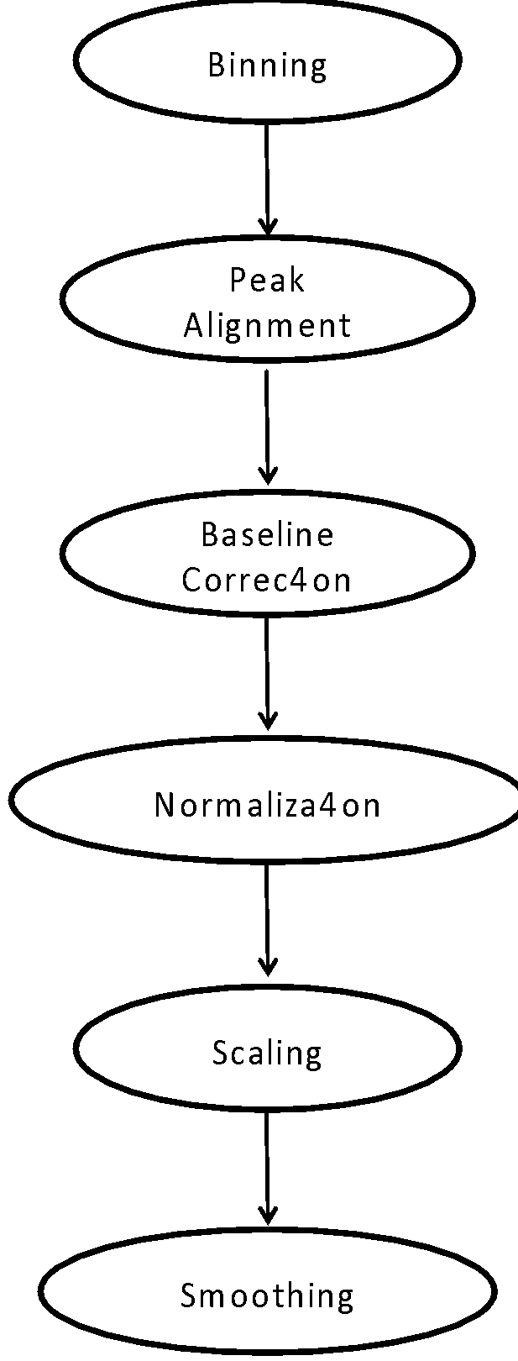
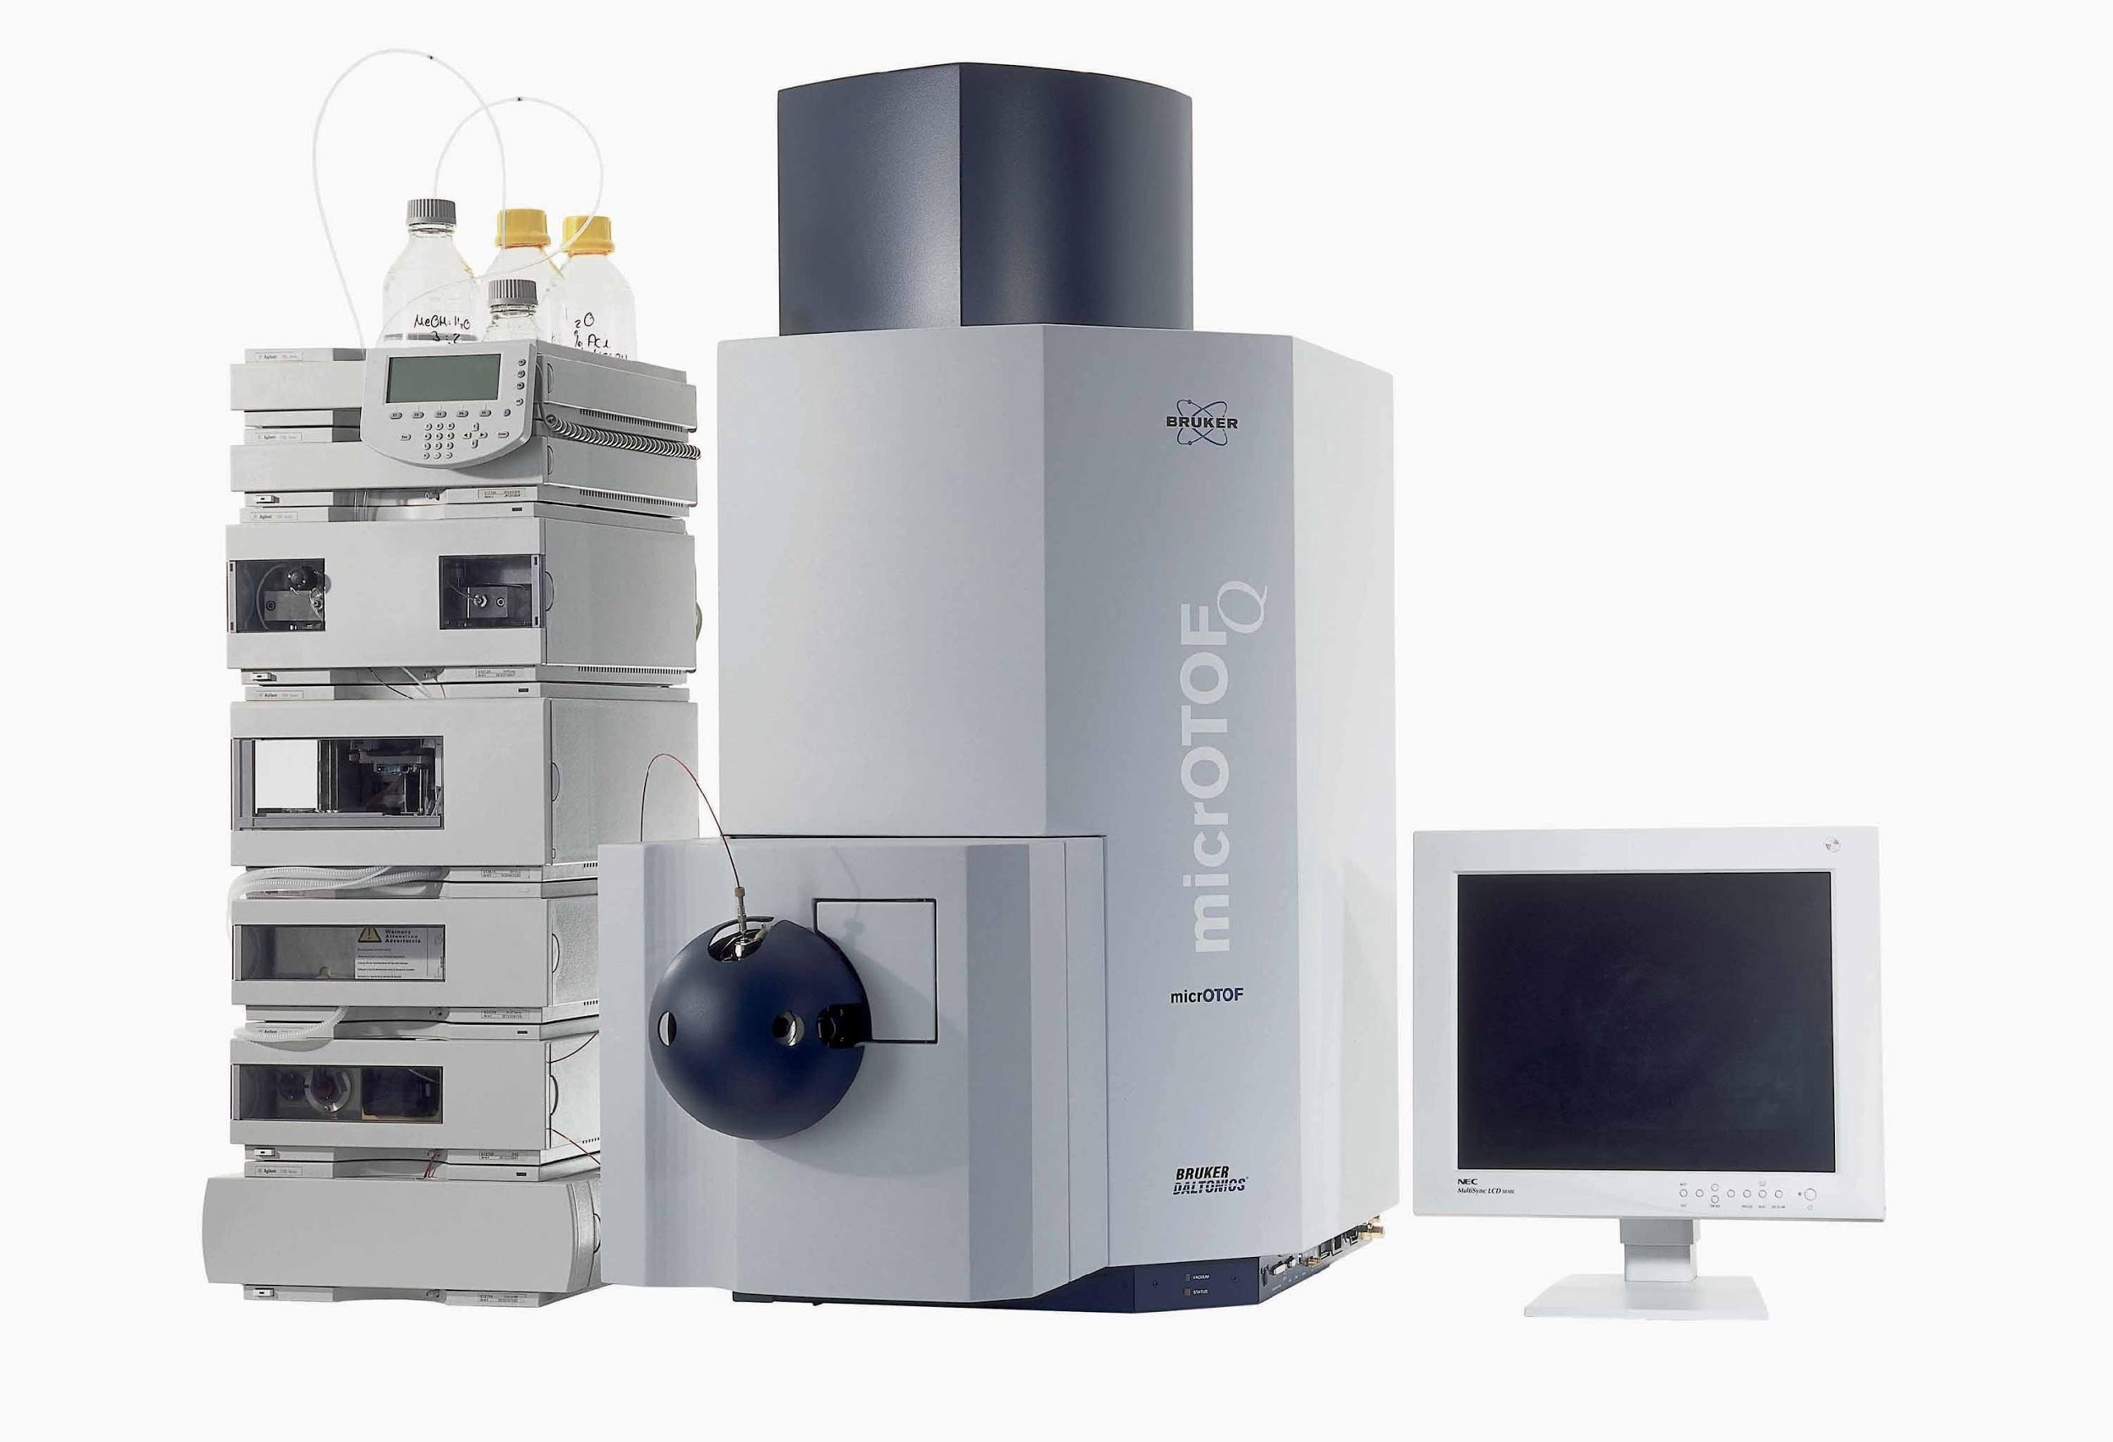
TB Project: Serological Biomolecule Profiling and Biopattern Recognition in Tuberculosis Diagnosis and Treatment Monitoring

Slide 14
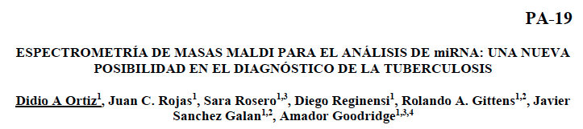
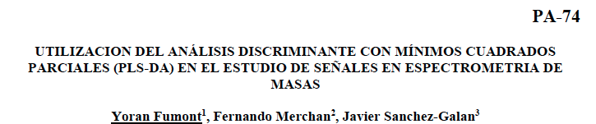

Slide 15
Bio & Agro

Slide 16
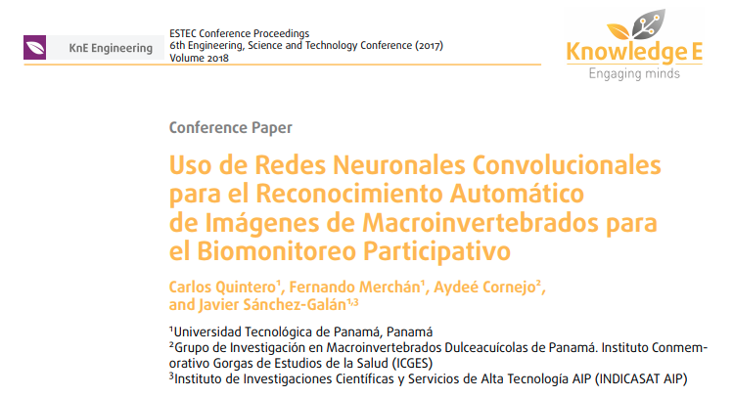
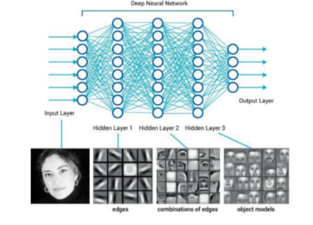
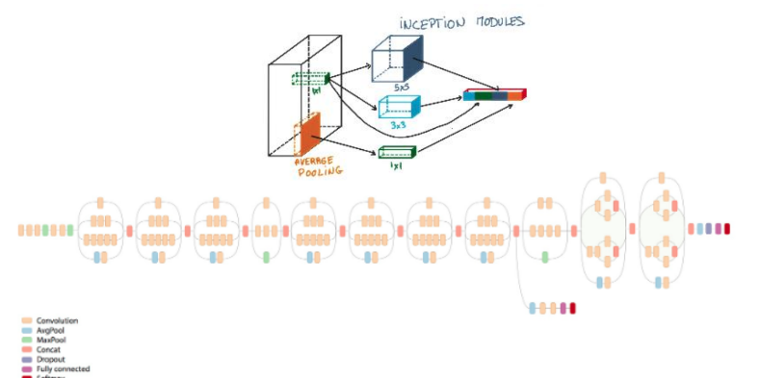

Slide 17
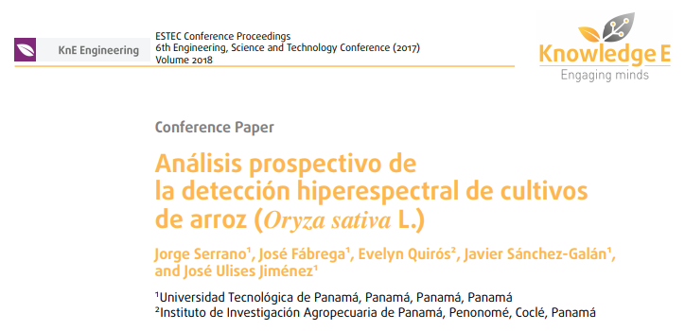
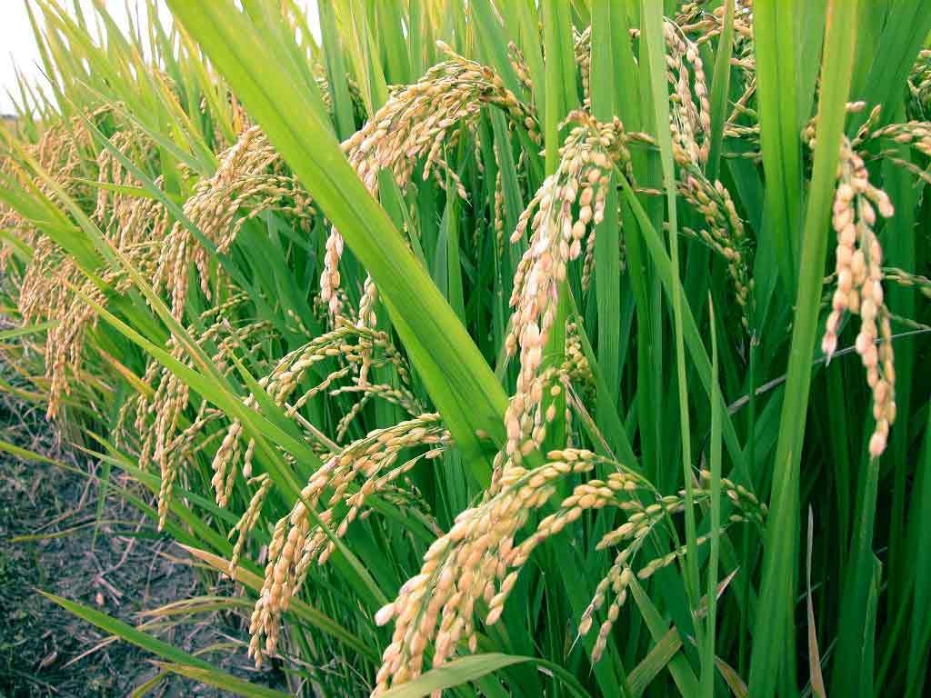
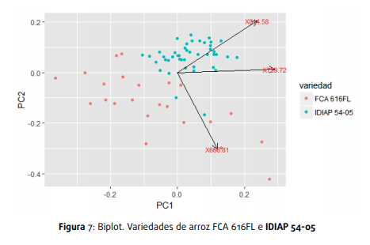
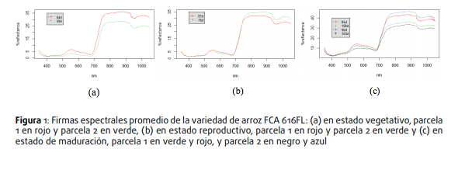

Slide 18
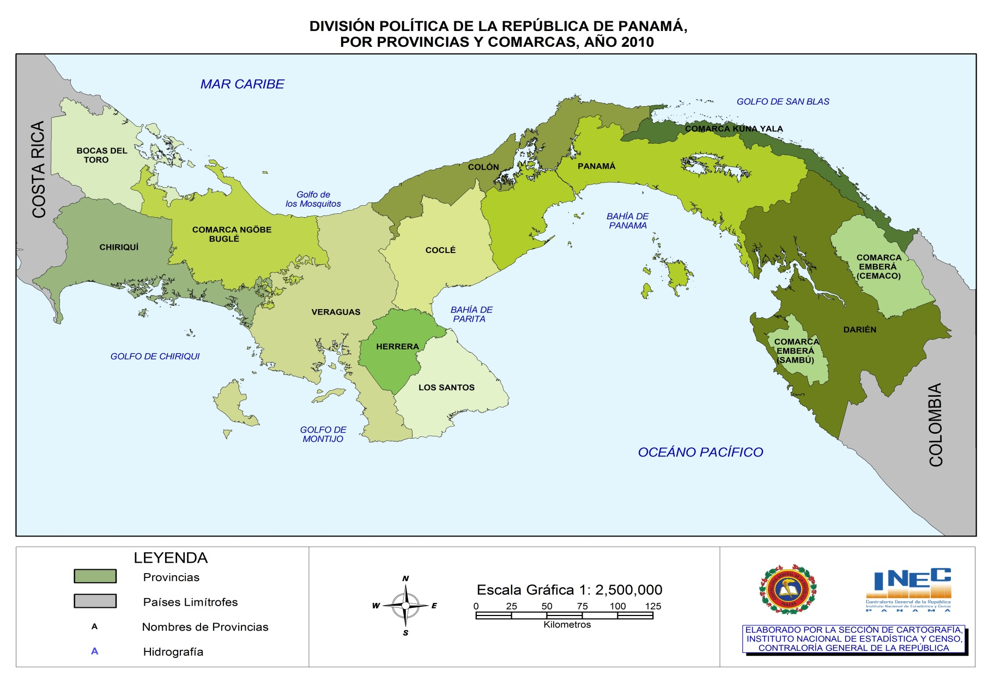
Plant Factories

Slide 19
Project: “Effects of LED lights on nutritional quality, growth and development of lettuce in controlled environments”
2 shelves with 3 levels will be used to make the 5 treatments (5 replications), simultaneously
The experimental unit will consist of a plastic tray (55cm x 55cm x 10cm), with 16 seedlings An air pump will be used for each tray to keep the oxygen in the hydroponic solution
Substrate for root support will use sponge buckets

Slide 20
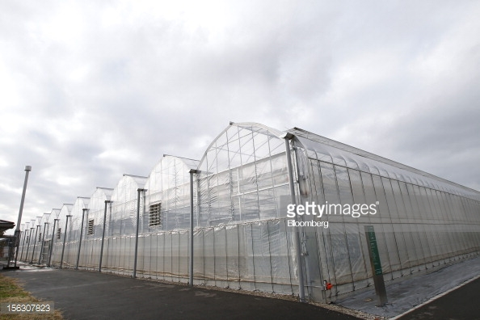
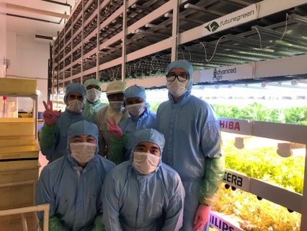
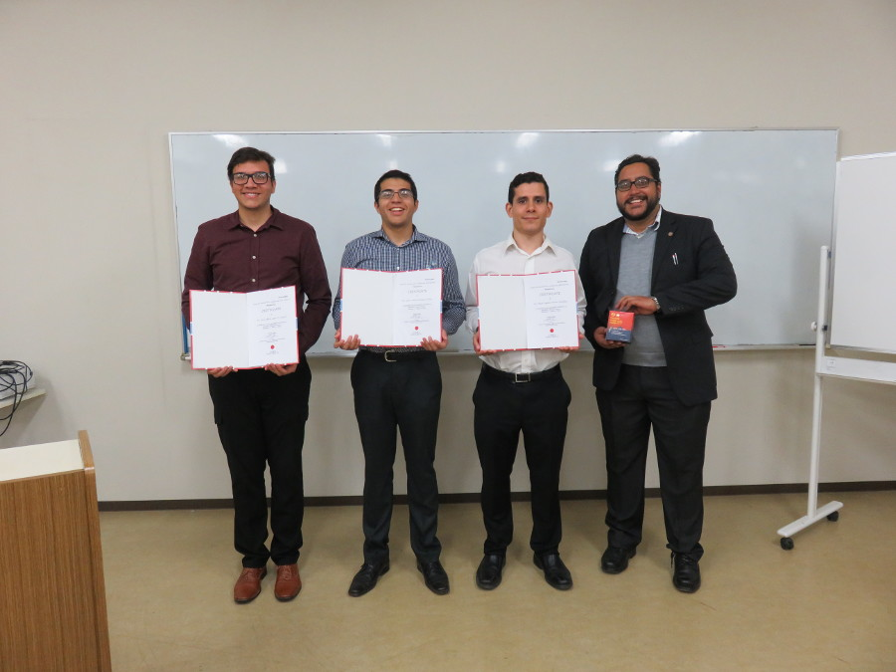
Plant Factories

Slide 21
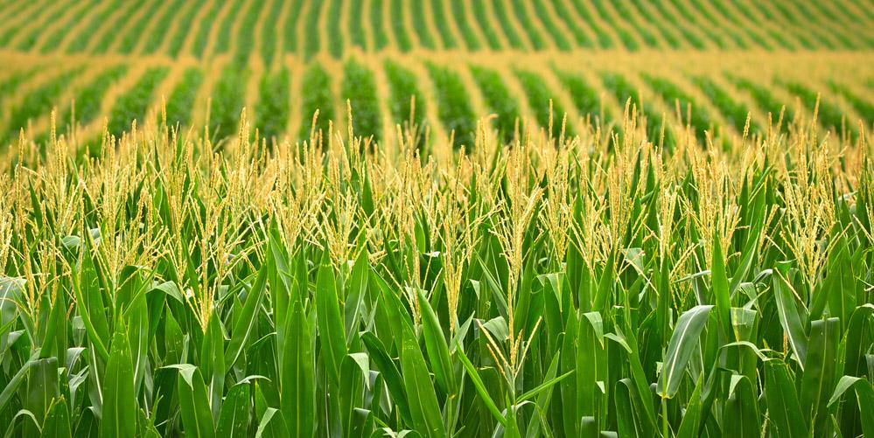
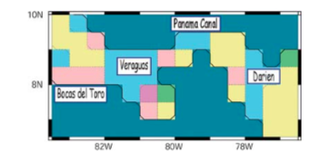
Future Climates & Maize Production
Project: Assessing future climates scenarios using a super-high resolution atmospheric-oceanic general circulation model (GCM) model adjusted for Panama: Implications in the Maize crop yield in the Azuero Peninsula
Objective: to provide an estimation of Maize crop yield in the near features and end-of-century future climates. Firstly, there will be an assessment of the impact of humidity and precipitation, however other variables reducing yield, such as: UV Radiation, Solar Energy, will be explored.

Slide 22
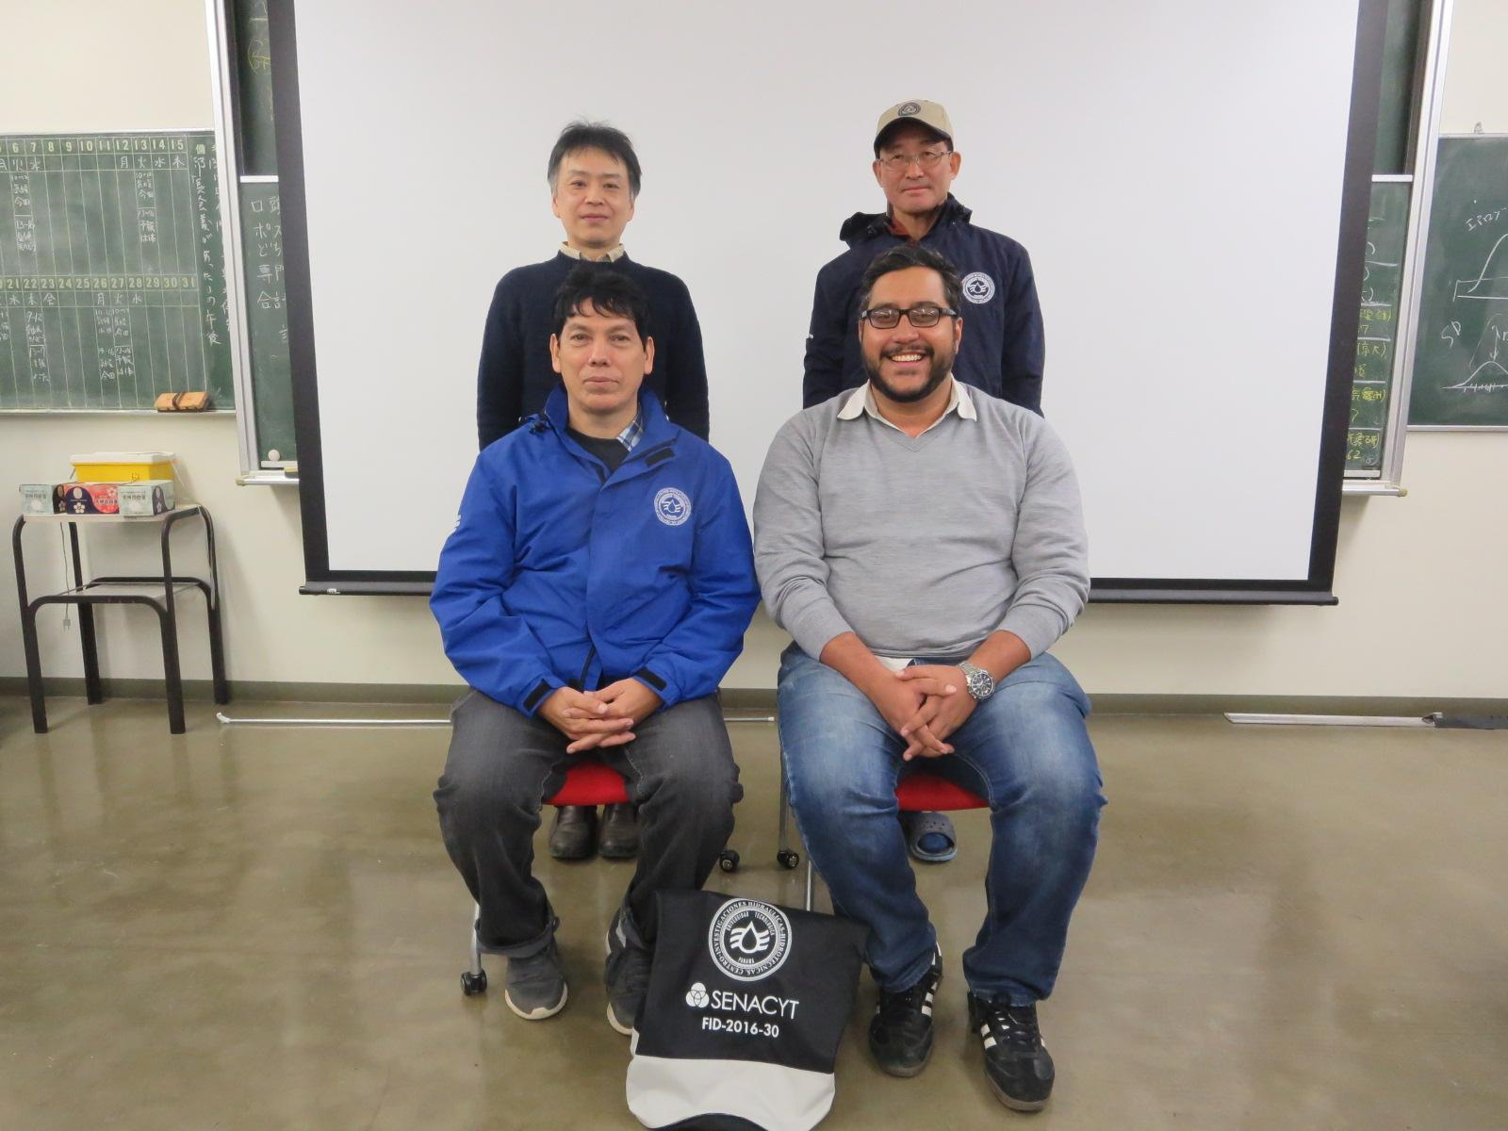
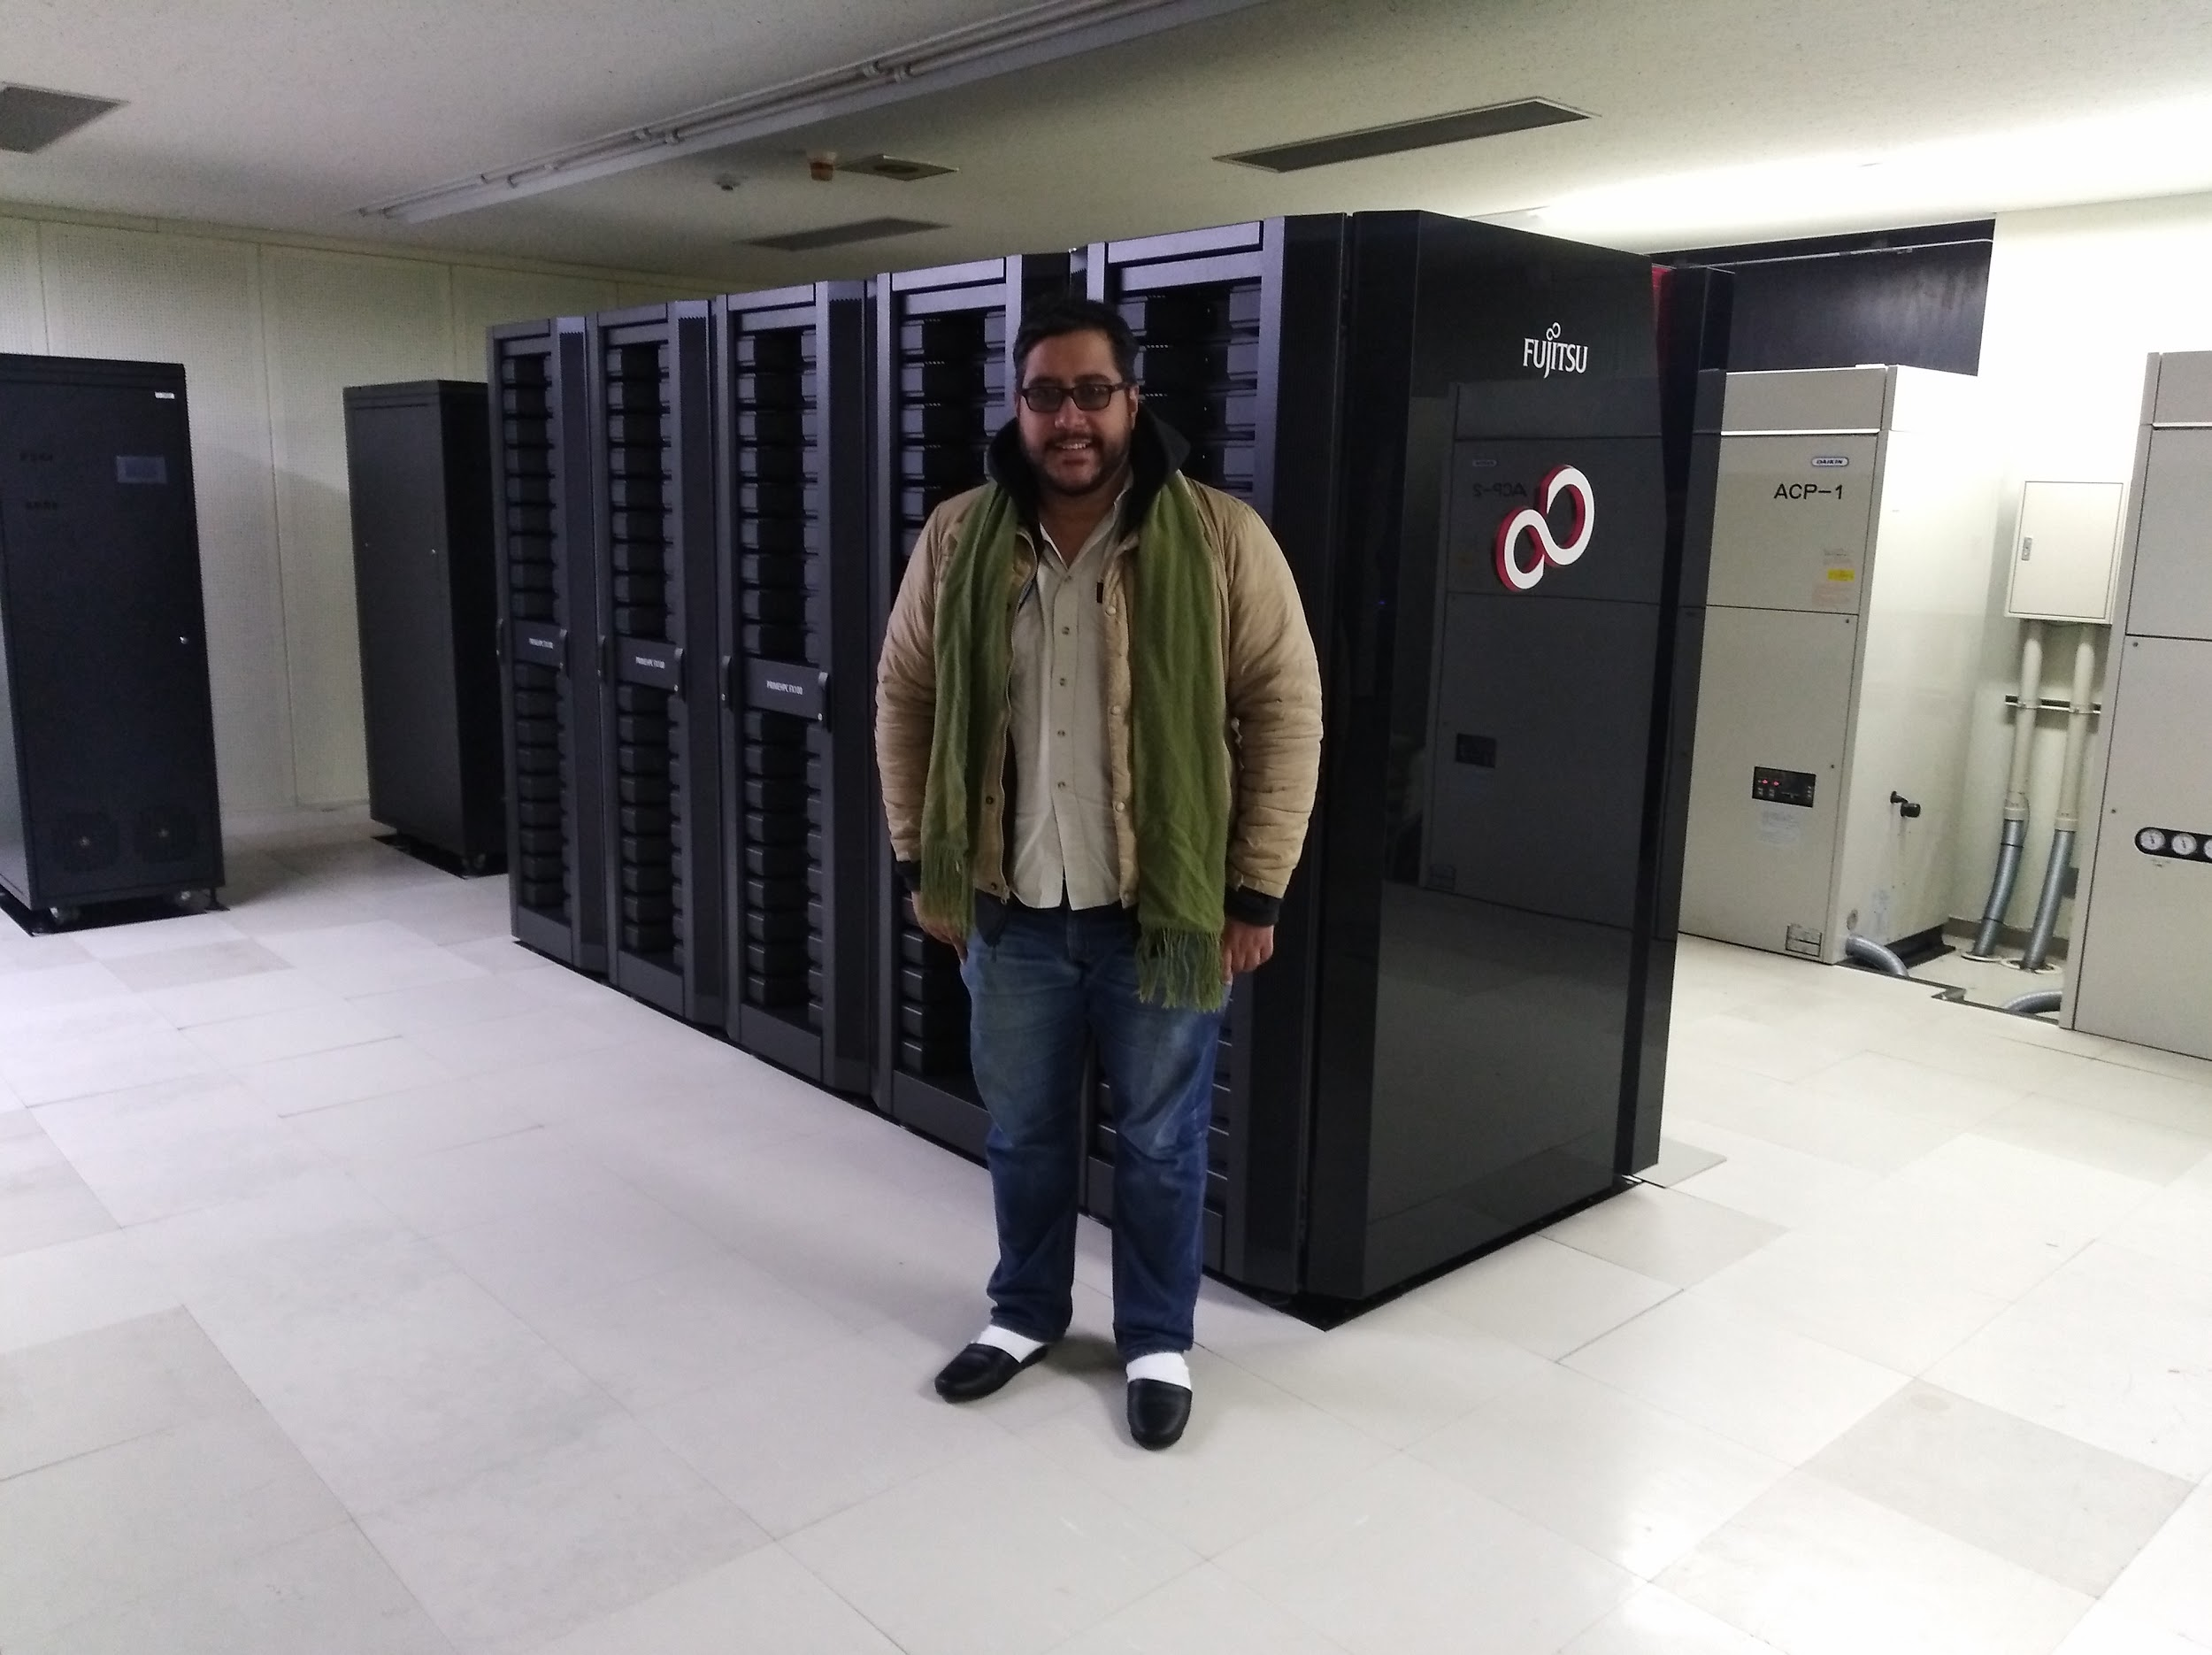
Future Climates & Maize Production

Slide 23
Grupo de Investigación en Biotecnología, Bioinformática y Biología de Sistemas – GIBBS
Javier Sánchez Galán, PhD
javier.sanchezgalan@utp.ac.pa
@utppanama

